Slide 1





CS-513 FINAL PROJECT
Heart Stroke Analysis
Group 5
Name: Jay Bhesania
ID: 20011391
Section: B
Dept: CS
Level: Graduate
Name: Aishwarya Patel
ID: 20009009
Section: B
Dept: CS
Level: Graduate
Name: Punjal Avadhiya
ID: 20009308
Section: B
Dept: CS
Level: Graduate
Name: Priyanka Zala
ID: 20011474
Section: B
Dept: CS
Level: Graduate

Slide 2
INTRODUCTION
Stroke is one of the leading global causes of death and permanent disability. To improve prevention and early treatment, it is crucial to be able to anticipate the risk of having a stroke.
According to the World Health Organization (WHO) stroke is the 2nd leading cause of death globally, responsible for approximately 11% of total deaths.
Stroke is a medical condition that can lead to the death of a person. It’s a severe condition and if treated on time we can save one’s life and treat them well. There can be n number of factors that can lead to strokes and in this project blog, we will try to analyze a few of them.

Slide 3
PROBLEM STATEMENT
The major challenge in heart disease is its detection. There are instruments available which can predict heart disease but either they are expensive or are not efficient to calculate chance of heart disease in human. Early detection of cardiac diseases can decrease the mortality rate and overall complications.
However, it is not possible to monitor patients every day in all cases accurately and consultation of a patient for 24 hours by a doctor is not available since it requires more sapience, time and expertise. Since we have a good amount of data in today’s world, we can use various machine learning algorithms to analyze the data for hidden patterns. The hidden patterns can be used for health diagnosis in medicinal data.

Slide 4
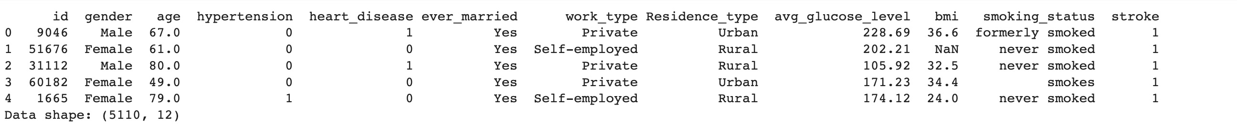

DATASET
The dataset has 12 columns (variables) and 43400 rows (samples), ten of which are the input variables and are listed in Table 1 along with their descriptions. The remaining two variables are "id" (not included in our studies), which represents the patient's ID, and "stroke," which is utilized as the output variable and has a value of 0 (no stroke) or 1 (stroke) (target).

Slide 5


Goal & Objective
The main objective of our project is to develop the classification models to predict the occurrence of stroke in patients.
We have created 8 different types of classification models.

Slide 6
PRE-PROCESSING
The management of a highly unbalanced class can be accomplished using a variety of strategies. In order to have the same amount of samples as the majority class , we will generate new samples from the minority class using an oversampling approach called Synthetic Minority Oversampling Technique (SMOTE) . We selected the oversampling strategy since using the under sampling technique would result in a considerable loss of information (97.88%).

Slide 7
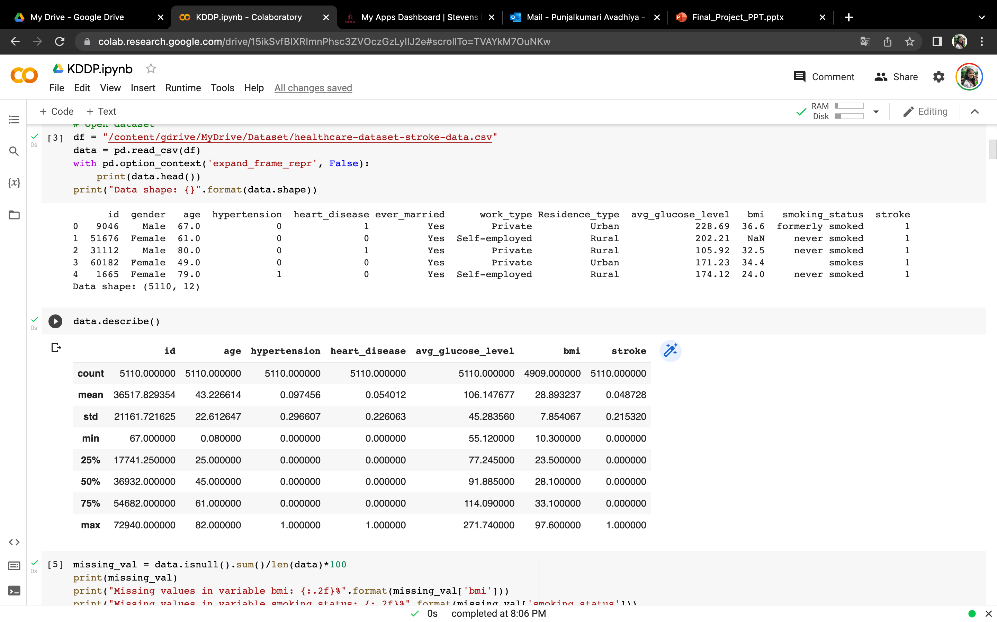
SUMMARY OF THE DATASET

Slide 8
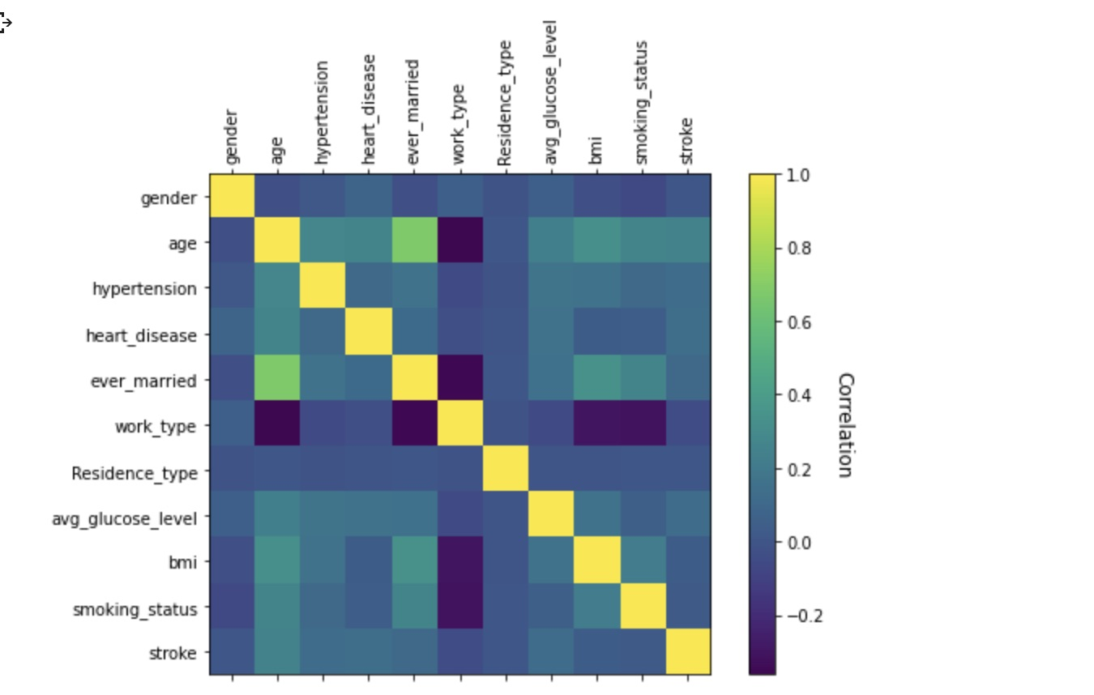
Correlation Plot for Variables

Slide 9
ALGORITHMS USED
Logistic Regression (LR)
Gaussian Naive Bayes (GNB)
Decision Tree (DT)
LightGBM (LGBM)
K – Nearest Neighbor (KNN)
XGboost (XGB)
Random Forest (RF)
Singular Vector Machine (SVM)

Slide 10

Logistic Regression (LR)
When do we use?
Prediction problems
How do we use?
Artificial Neural Network(ANN) uses the processing of the brain as a basis to develop algorithms that can be used to model complex patterns and prediction problems.

Slide 11
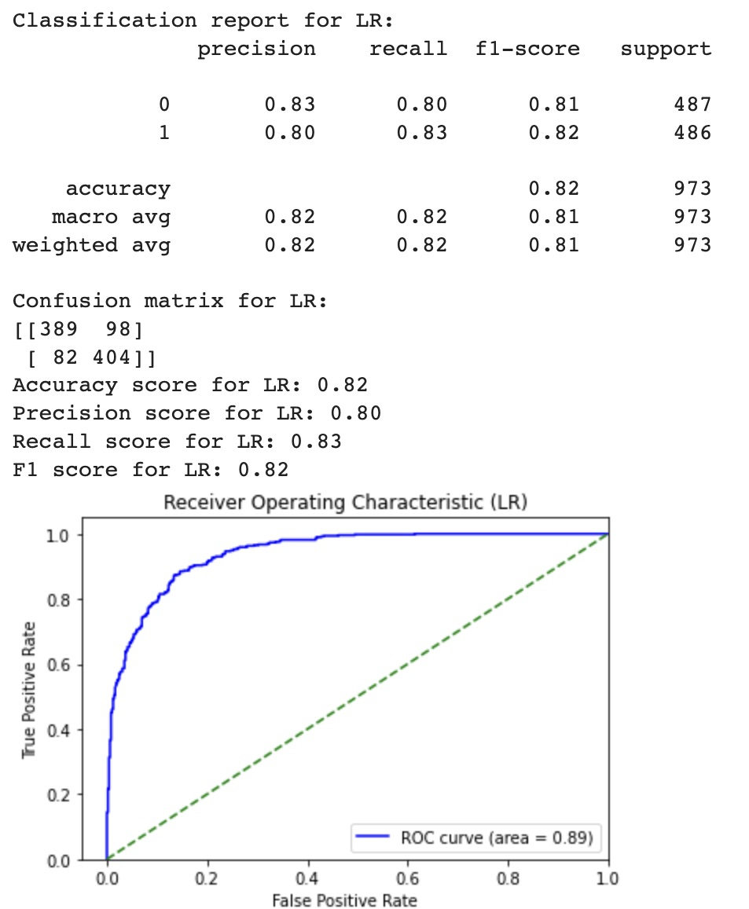
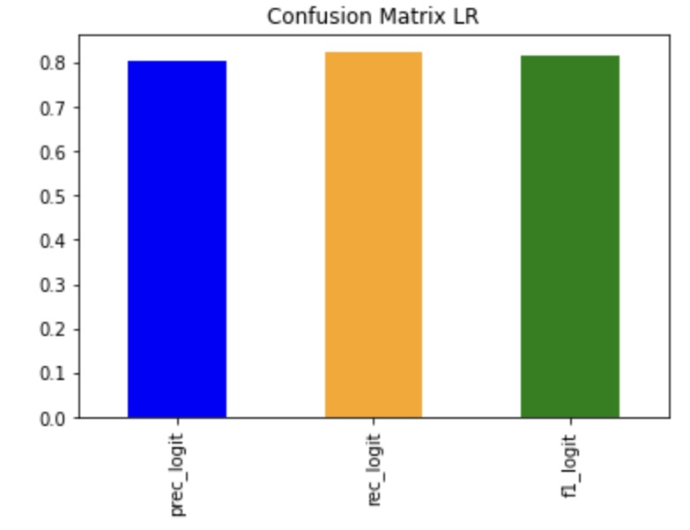
Logistic Regression (LR)
OUTPUT:

Slide 12
Gaussian Naïve Bayes(GNB)
When do we use?
Classification Problems
How do we use?
Based on Bayes Theorem – every feature being classified is independent of the value of any other feature
Allows to predict a class given a set of features using probability

Slide 13
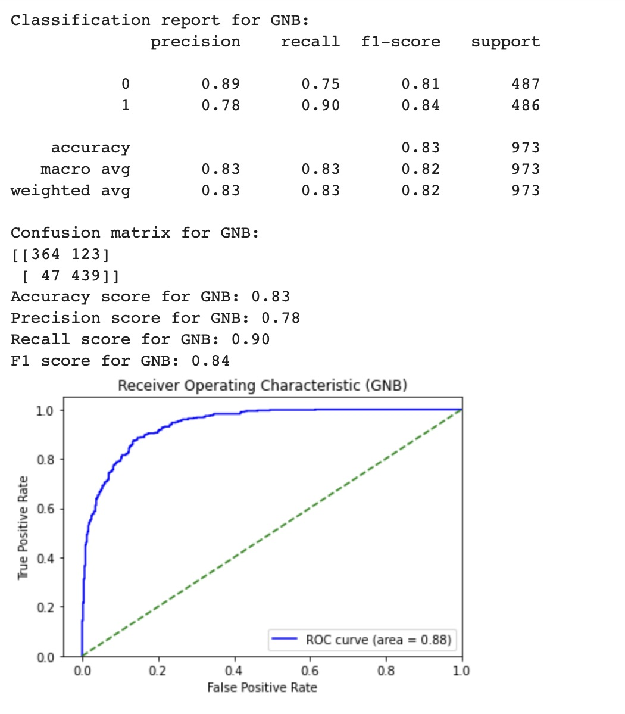
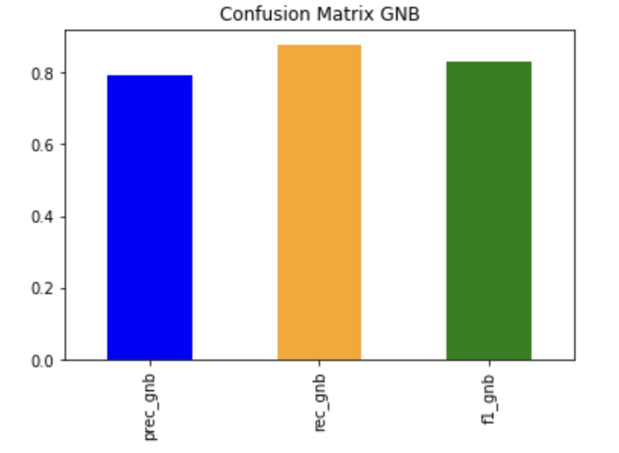
GAussian Naïve Bayes
OUTPUT:

Slide 14
Decision Tree
When do we use?
Classification and Regression problems
How do we use?
The purpose of the analysis via tree-building algorithm is to determine a set of if-then logical split conditions that permit accurate predictions or classification of cases.
A Classification tree will determine a set of logical if-then conditions instead of linear equations for predicting or classifying cases.

Slide 15
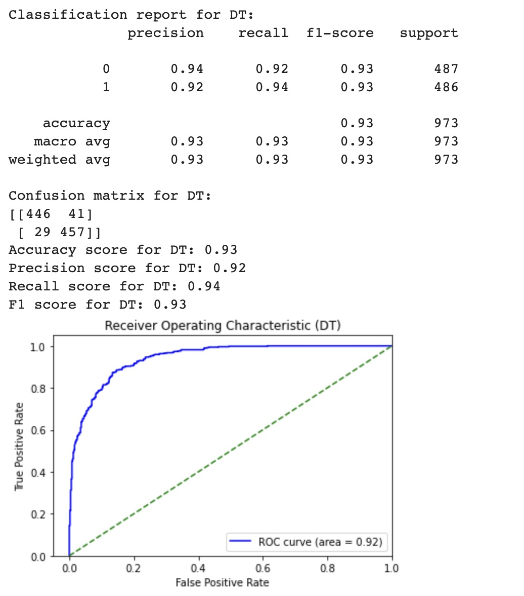
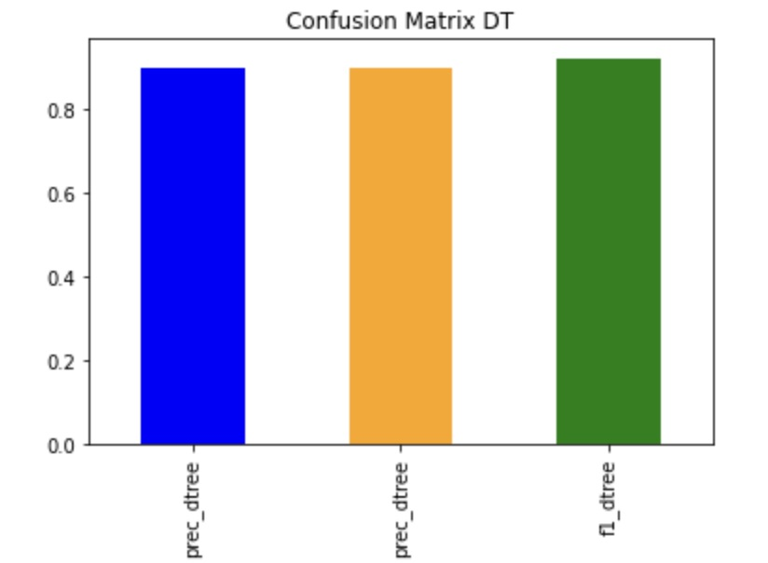
Decision Tree
OUTPUT:

Slide 16
LightGBM (LGBM)
When do we use?
Prediction problems
How do we use?
LightGBM is a gradient boosting framework based on decision trees to increases the efficiency of the model and reduces memory usage. Gradient-based One Side Sampling Technique for LightGBM: Different data instances have varied roles in the computation of information gain.

Slide 17
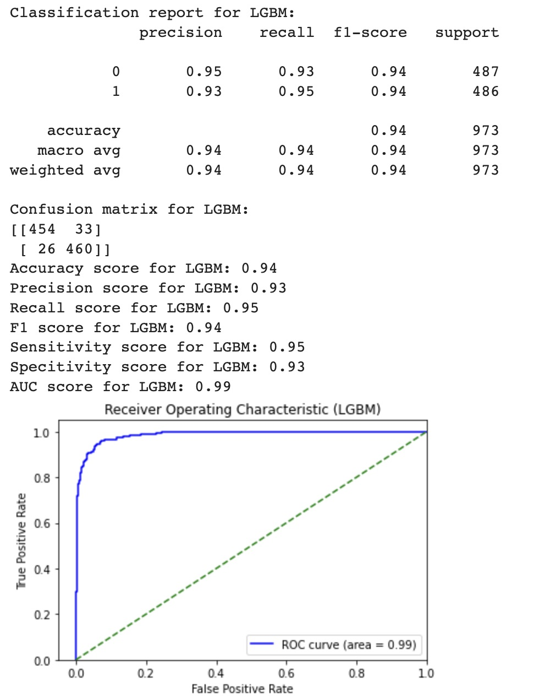
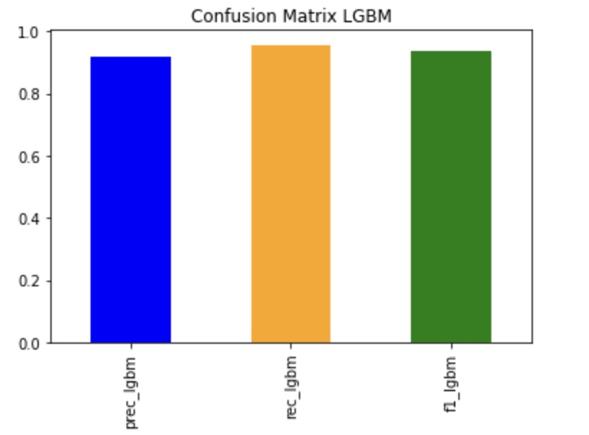
LightGBM (LGBM)
OUTPUT:

Slide 18
K-nearest Neighbor (KNN)
When do we use KNN?
For Classification and Regression Problems
How Do we use KNN?
Classification of a new unclassified record is performed by comparing it to the record in the training set it is most similar to, based on distance matrix.

Slide 19
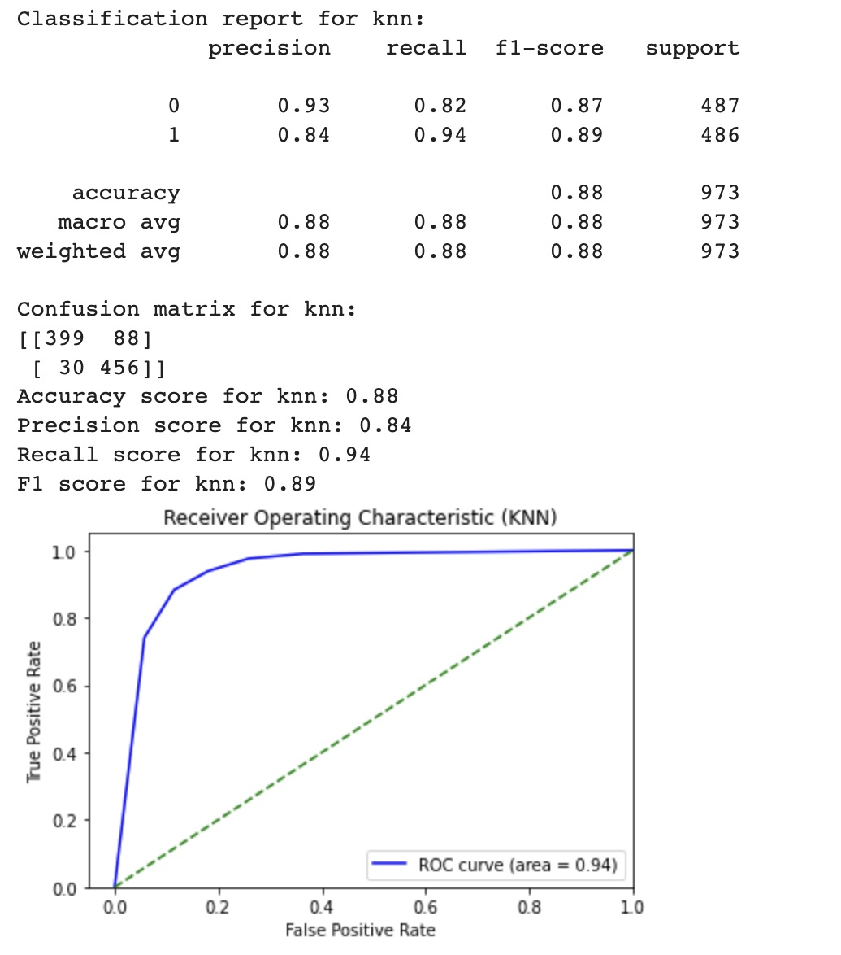
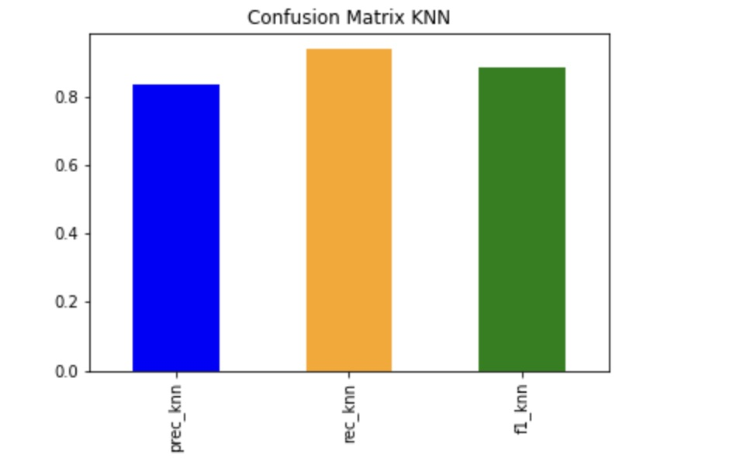
K – nearest Neighbor
OUTPUT:

Slide 20
Random Forest (RF)
When do we use?
Classification and Regression problems
How do we use?
Random forest, like its name implies, consists of a large number of individual decision trees that operate as an ensemble.
Each individual tree in the random forest spits out a class prediction and the class with the most votes becomes our model’s prediction

Slide 21
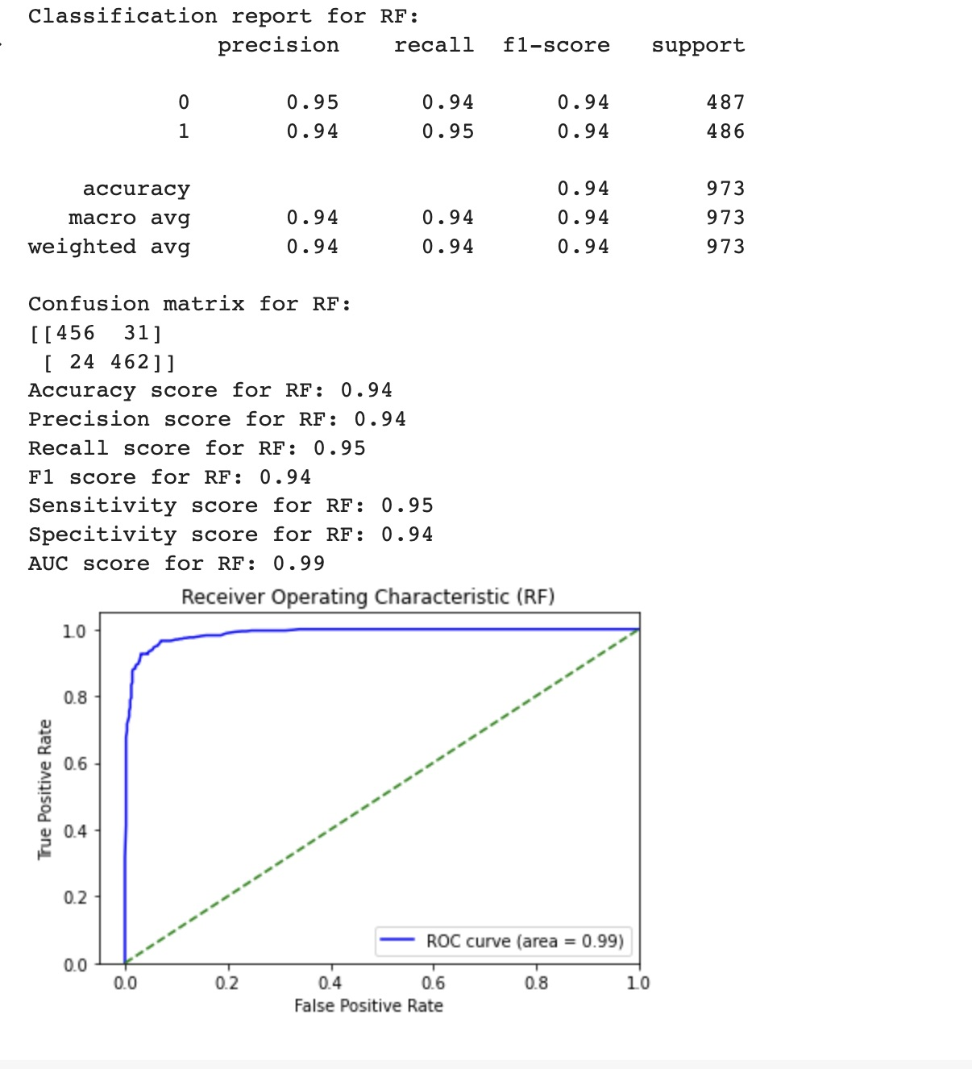
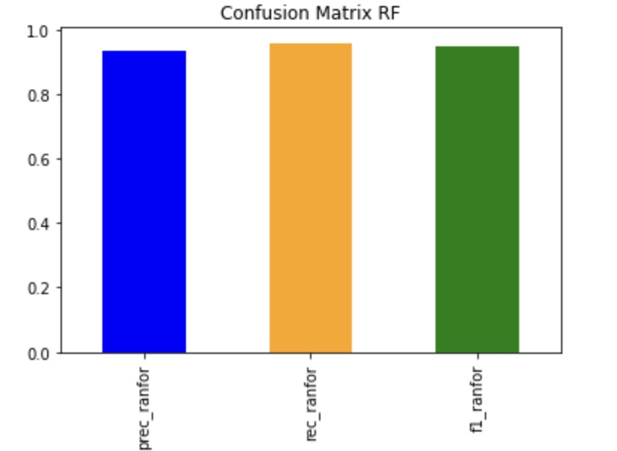
Random Forest
OUTPUT:

Slide 22
XGboost (XGB)
When do we use?
Prediction problems
How do we use?
XGBoost (eXtreme Gradient Boosting) is a popular supervised-learning algorithm used for regression and classification on large datasets. It uses sequentially-built shallow decision trees to provide accurate results and a highly-scalable training method that avoids overfitting.

Slide 23
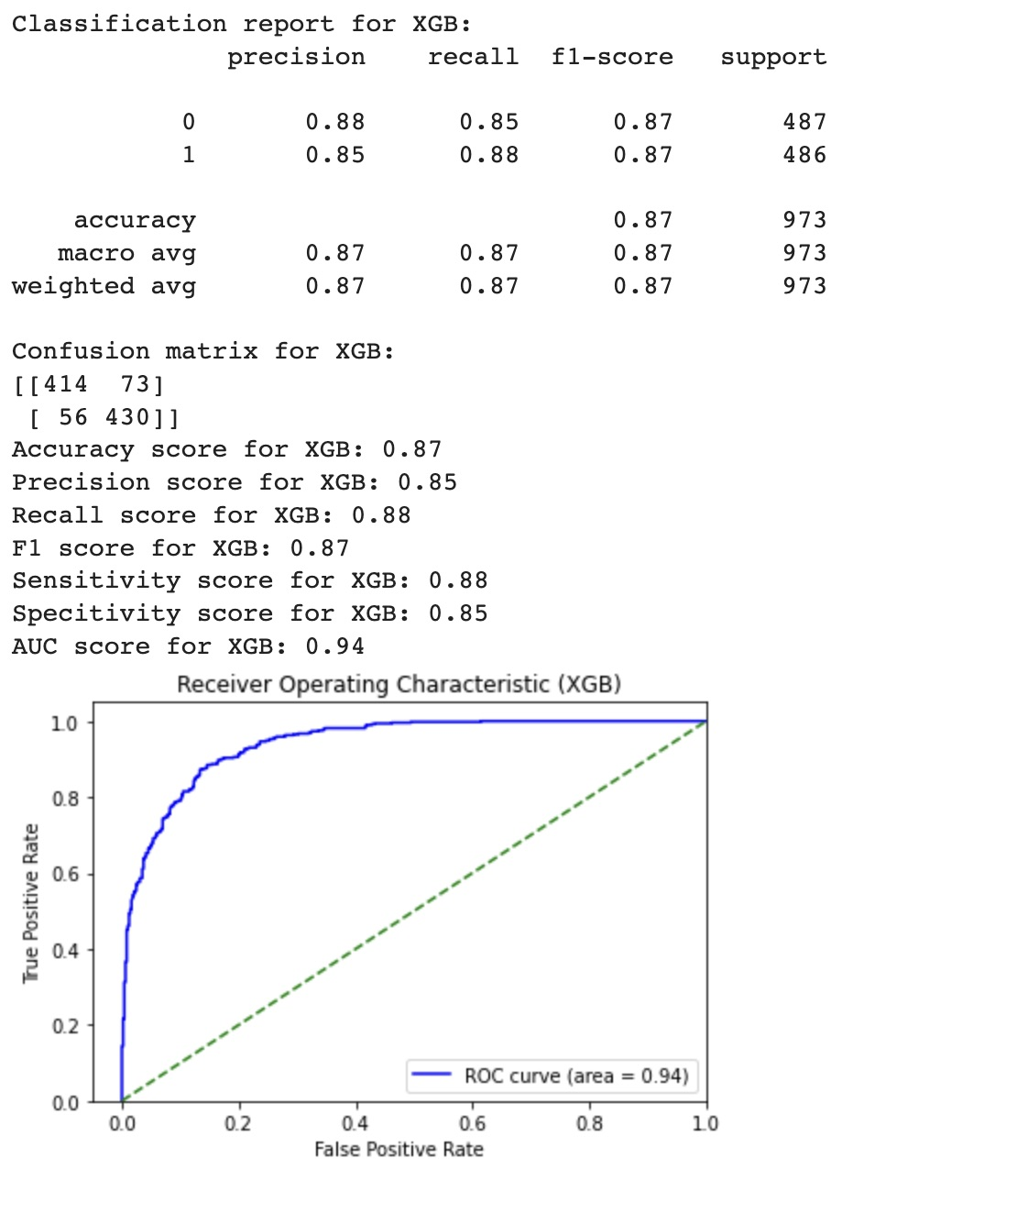
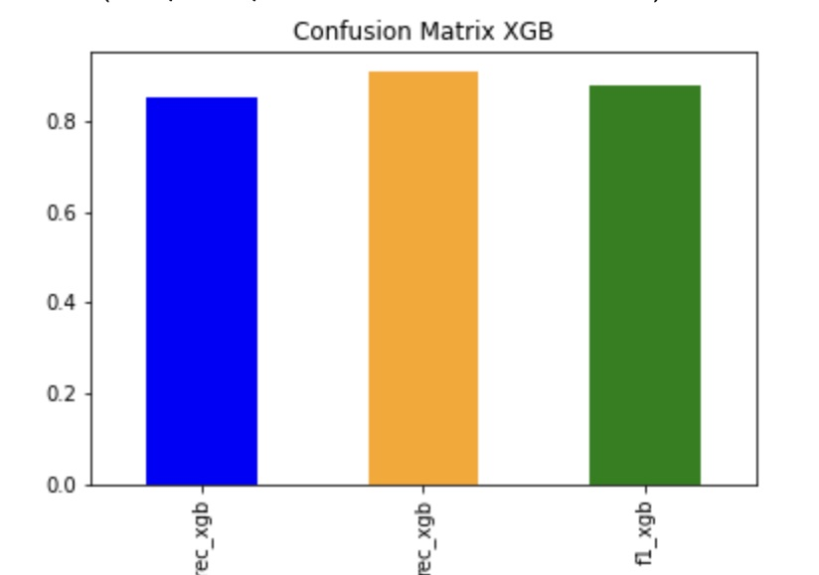
XGboost (XGB)
OUTPUT:

Slide 24
Support Vector Machine (SVM)
When do we use?
Classification and Regression problems
How do we use?
SVM works by mapping data to a high-dimensional feature space so that data points can be categorized, even when the data are not otherwise linearly separable.
A separator between the categories is found, then the data are transformed in such a way that the separator could be drawn as a hyperplane.

Slide 25
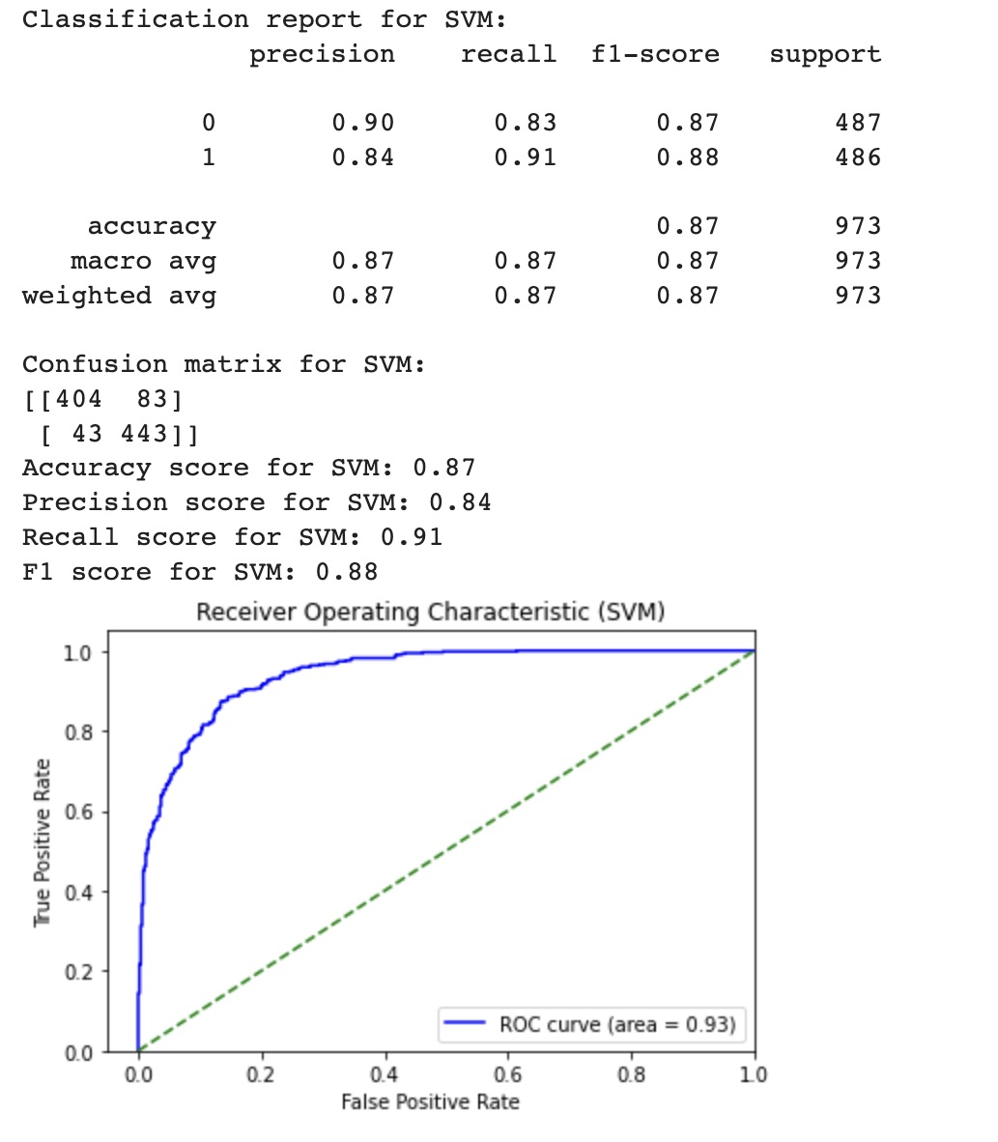
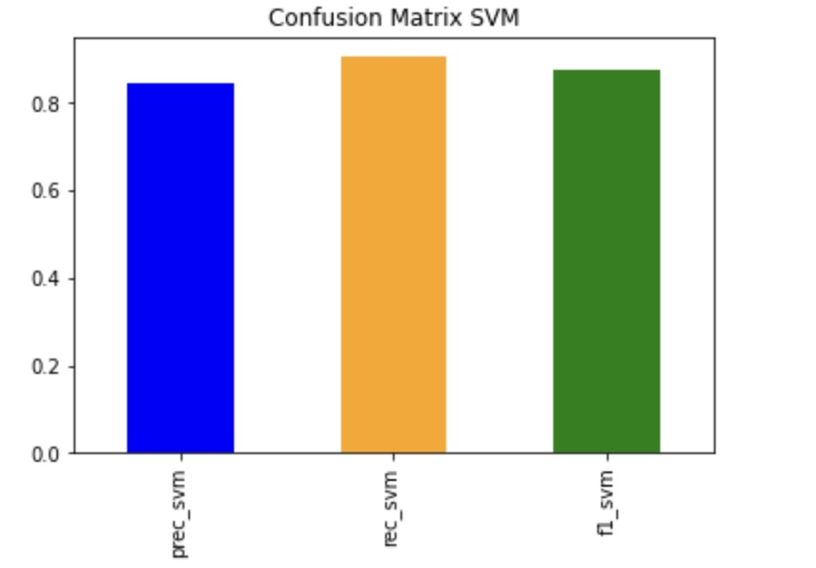
Support Vector Machine
OUTPUT:

Slide 26
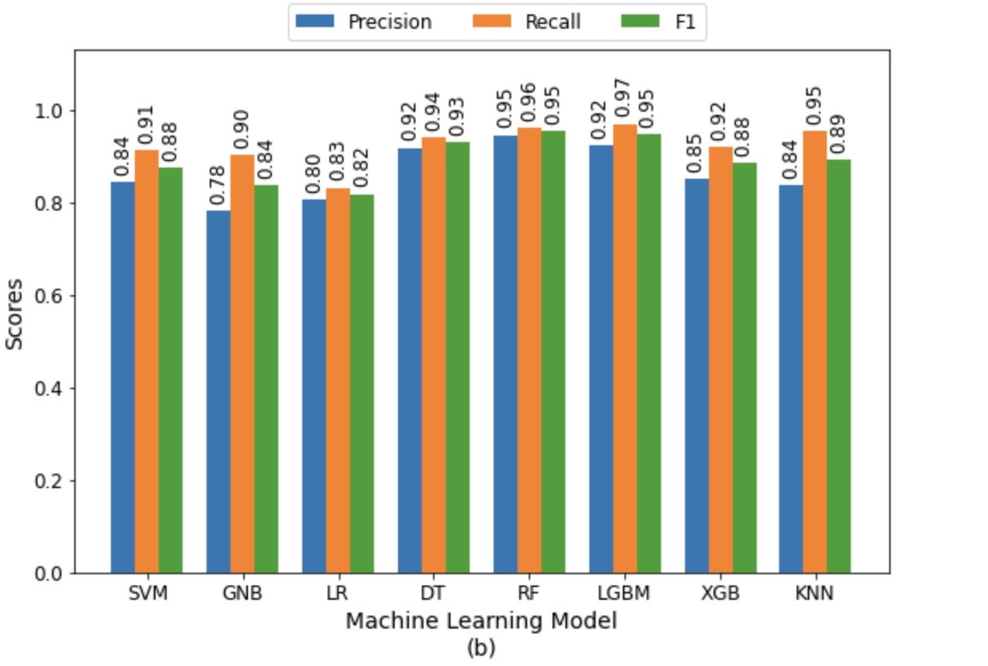
Comparison and conclusion
From all the models we have used we concluded that the for the purpose of predicting strokes, we provided a thorough study of patient characteristics in the health record. We thoroughly examined several features. For the purpose of selecting the best collection of features, we conducted feature correlation analysis and a step-by-step analysis. For this combination, the accuracy are 75% - 98%, respectively.

Slide 27
Thank you

